Slide 1
IRB Review of Community-Based Participatory Research
Notes:
Welcome to the Human Subjects Office presentation for IRB Review of Community-Based Participatory Research.

Slide 2
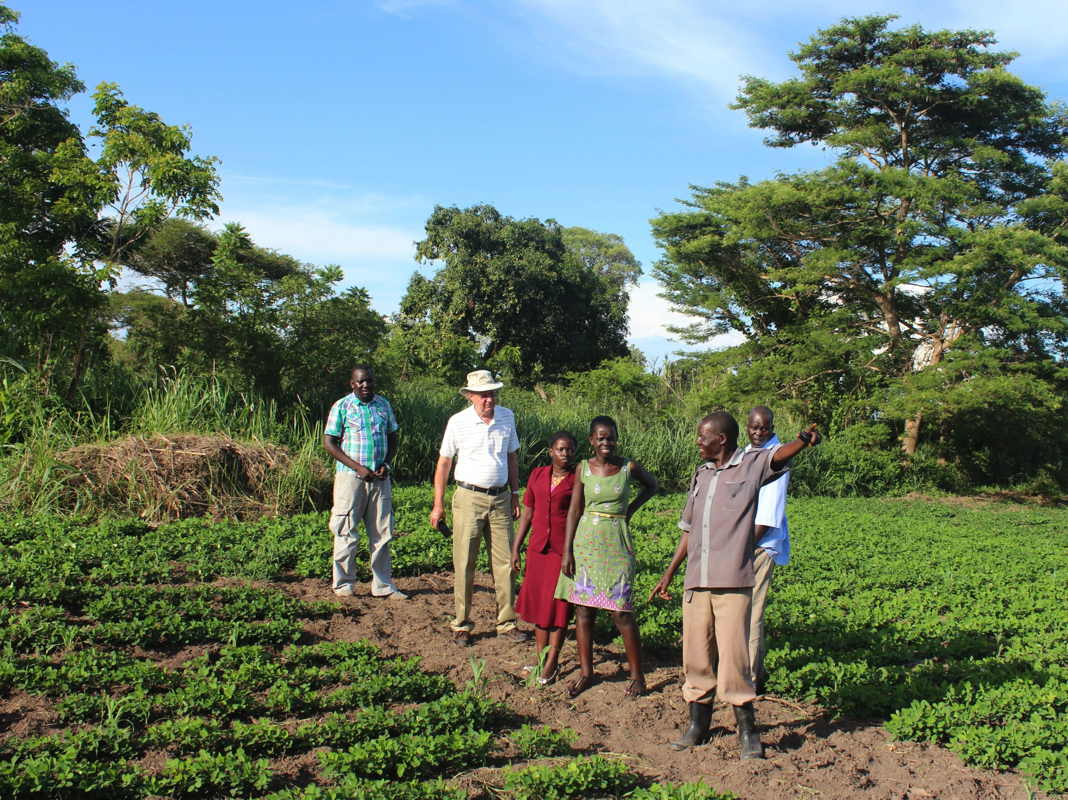
Where do I start?
Notes:
Community-based participatory research typically begins with a research topic of importance to the community, and has the aim of combining knowledge with action and instituting change to improve the well-being of the community. The community generally actively participates in the full spectrum or majority of the research process, such as the conceptualization or design, conduct or implementation, analysis and interpretation of data, conclusions, and communication of results. This presentation will discuss the aspects of study design with emphasis on: overall study design, constructing research questions, and the specific challenges when designing community based research.

Slide 3
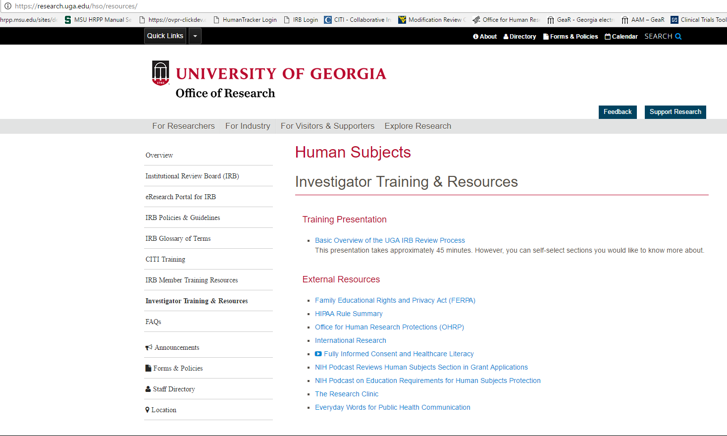
IRB Process Basic Overview https://research.uga.edu/hso/resources
Notes:
While this presentation will cover some of the basic human research submission topics, we recommend our Basic Overview presentation for first time submitters or for anyone just wanting a refresher on certain topics.

Slide 4
History:
Human Subjects Research Protection
1974
  Congress established National Commission for the Protection of Human Subjects of Biomedical and Behavioral Research
1979
  National Commission met in Belmont, NY and drafted “Ethical Principles and Guidelines for the Protection of Human Subjects of Research (Belmont Report)
1991
  The Belmont Report forms the basis of the “Common Rule” that is adopted by 17 US Governmental Agencies
2017
  Proposed New Rule published. If accepted by DHHS, full compliance required by January 19, 2018.
Notes:
Let’s start with a little history. Modern human research protections became a national concern in response to investigations of misconduct post WWII and following termination of the Tuskegee Syphilis Trial. The National Research Act led to the establishment of a National Commission that met in Belmont, New York to design guidance for the protections of human participants of research. The Belmont Report formed the basis for the Common Rule that was promulgated into regulation for many federal agencies and departments. While there were a few minor amendments (Subparts) added over the years, the first major overhaul was proposed recently.

Slide 5



Belmont’s 3 Key Ethical Principles
Respect for Beneficence Justice
Persons
Consent
Risks vs. Benefits
Selection and Recruitment
Notes:
In addition to requiring a Federal Wide Assurance (FWA) to be filed with the Office for Human Research Protections and an IRB for each FWA, the Belmont Report also described the difference between practice and research and three key ethical principles:
Respect for Persons – The right of a person to choose or decline to participate in research, without undue influence or coercion,
Beneficence – The idea of weighing the benefits of research against the risk of harm to the participants, and
Justice – The idea that individuals and groups should be treated fairly and equitably in terms of bearing the burdens of research and receiving the benefits.

Slide 6

Research
Research is…
a systematic investigation designed to develop or contribute to generalizable knowledge.
Notes:
We’ll start with the first question that the IRB considers when reviewing a submission: does this project involve research? The federal definition of research involves two parts: a systematic investigation and generalizable knowledge.

Slide 7
Systematic Investigation
Has a research question (hypothesis)
An activity that is methodologically driven
Involves a prospective plan
Data or information is collected in an organized and consistent way
The data or information is analyzed in some way, usually quantitatively or qualitatively
Conclusions can be drawn from the results
PROTOCOL
Notes:
What is a systematic investigation? It is a plan for a project that articulates the research questions, describes the methods and processes for collecting information to answer or support the research questions, and provides a way to analyze the information so that conclusions can be drawn. The systematic investigation is often referred to as a protocol.

Slide 8
S.M.A.R.T
S.M.A.R.T. is an acronym that is used to guide the development of measurable goals.
Each objective should be:
Specific – Who, What, When, Where, Why, How?
Measurable – Quantify or at least suggest an indicator of progress
Attainable – Is this realistic? State what results can realistically be achieved given available resources.
Relevant – Are you collecting data that will help you answer your research question?
Time-related – Specify when the result(s) can be achieved
Notes:
When designing a protocol, the IRB recommends relying on S.M.A.R.T. objectives. Be sure to include sufficient detail that someone outside of your study team could follow the steps to conduct the project. Define the limits of the project: time, sample size, number of activities. Avoid designing a project with no end or no limits on the information to be obtained. If there are no limits, the project may be considered to have limitless risk which may significantly impact the IRB risk assessment. For this reason, consider all of the factors or variables you want to explore and be sure to articulate them in the description of the research design. For example, if age of the participant may affect a certain behavior you are studying, state this in the submission and be sure to collect this information via an instrument (e.g., a survey or interview question.) Finally, collect information relevant to your study. The IRB may ask why the survey includes a question about religious preference if you haven’t indicated in your design description that this is relevant to your analyses.

Slide 9


Service Needs Assessment
Census data
Phone book listings
Phone interviews with agencies/businesses about services provided and population served
Systematic Investigation?
Notes:
A sample may help to illustrate the concept of systematic investigation. Our sample study involves assessing a local community with a high number of Spanish-speaking families to determine if there are adequate services available or if the local council should focus efforts on fostering or encouraging additional organizations to provide services. We will use census data to determine the potential size of the population (self-reported Hispanic or Latino). We will review Internet and phone listings for organizations within the community to see how many of them advertise service to Spanish-speaking individuals. We will then call these organizations and conduct interviews to determine what services they provide to the Spanish-speaking community. We will call other organizations that advertise similar services to determine if they service Spanish-speaking individuals. We will aggregate this information to provide a profile of the local service organizations and compare this to the potential population so that we can assess whether or not Spanish-speaking individuals have adequate access to community services. The elements of a systematic investigation are present so the first part of the federal definition of research is met.

Slide 10
Research
Research is…
a systematic investigation designed to develop or contribute to generalizable knowledge.
Notes:
The second part of the definition requires that the systematic investigation was designed to develop or contribute to generalizable knowledge.

Slide 11


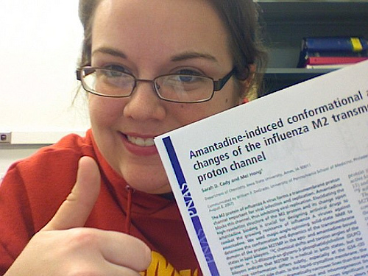
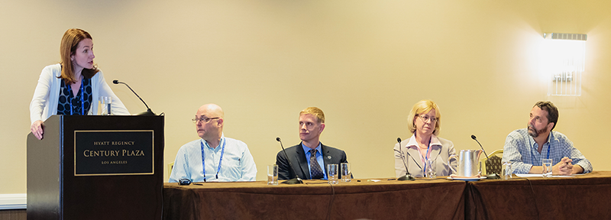
Generalizable Knowledge
def. – information or themes that can be transferred to other situations
X
Add to our body of knowledge
Useful to people outside of the research group
Notes:
What is generalizable knowledge? It is information that adds to a body of knowledge about a behavior, disease, or phenomenon. It is information about which conclusions can be drawn that are useful to people other than those included in the study sample. The intention to publish or present the information publicly is not the sole criterion on which to base a determination that the information is generalizable. While the federal regulations do not define generalizable knowledge, it can be considered as knowledge that is widely applicable beyond the specific project for which it was collected. Sometimes the purpose of the project is more important to consider than the data collection methods.

Slide 12

Service Needs Assessment
Census data
Phone book listings
Phone interviews with agencies/businesses about services provided and population served
Generalizable Knowledge?
Notes:
So going back to our example. We are gathering this information so that we can provide the information to the local council. We hope that this will encourage them to facilitate making more resources available to this growing segment of the county population. Our information is limited to the local context as well. Therefore, these activities are not designed to develop or contribute to generalizable knowledge. While the information may be useful to others outside the group, the design doesn’t collect any comparison information or ask questions of the agency personnel that would allow anyone to draw conclusions about all agency personnel or all service programs.

Slide 13
More on Generalizable Knowledge
What it isn’t:
Work for a private or public entity that generates a report to the same entity which cannot conceivably apply to another like entity (i.e., the data are UNIQUE/SPECIFIC, not generalizable).
What it is:
Work designed to have an impact (theoretical or practical) on others within one’s discipline. Work designed to influence behavior, practice, theory, future research designs, etc.
Notes:
Additional considerations when trying to determine if a project is designed to contribute to or develop generalizable knowledge include: defining the purpose or primary objects for doing the project, defining the potential results, and the potential audience for the results (e.g., who will benefit?) It is as important to define how information will be used as it is to define what information will be obtained.

Slide 14
Sometimes, it’s all about the QUESTION
1. Why did the chicken cross the road?
2. How many chickens crossed Broad Street in Durham, NC, on February 6, 2014?
3. What are some of the environmental factors that occurred in Durham, NC between January and February 2014 that would cause chickens to cross Broad Street?
https://twp.duke.edu/uploads/media_items/research-questions.original.pdf
Notes:
Consider the following research questions:
Why did the chicken cross the road? This question is too broad and does not define the segments of the analysis: which chicken? which road? OR Maybe the question is too narrow---are we only interested in this chicken and this road? How are we applying results to other chickens and roads?
How many chickens crossed Broad Street in Durham, NC, on February 6, 2014? Ostensibly, this question could be answered in one sentence and does not leave room for analysis. It could, however, become data for a larger argument.
Finally: What are some of the environmental factors that occurred in Durham, NC between January and February 2014 that would cause chickens to cross Broad Street? This question can lead to the author taking a stand on which factors are significant, and allows the writer to argue to what degree the results are beneficial or detrimental.

Slide 15
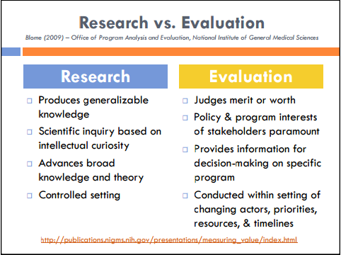
If you’re looking at a practice, ask yourself
“Is it Research or Evaluation?”
Notes:
Another way to consider how to articulate your research question or to describe your project to the IRB is to consider the differences between research and evaluation. When a project is designed to evaluate a process or program, you are often focused only on the stakeholders interest and the on summarizing information so that decisions about improvement or change can be made. The process/program is not changed to study the effects of the changes; it is conducted as is and the effects are observed and documented. When a project is designed for research, the data sought are those data which will satisfy an academic or scientific inquiry. The results are expected to apply to broad knowledge and theory. And any intervention or data collection is purposeful and controlled.

Slide 16



Community Help Agency
Missing segment of population needing services
Why?
Analyze Procedures
Barriers to expansion of program
  Talk to members of organization
  Cost analysis
    Talk to representatives of population
Systematic Investigation?
Generalizable Knowledge?
Notes:
Our second example takes the results of the service needs assessment and tries to figure out why certain agencies are perhaps missing entire segments of the local population in provision of services. We will collect procedure manuals and program information and make comparisons between agencies that were found to service Spanish speaking population with those who do not. We will interview members of the organizations who do not currently service the population to get more information about perceived barriers to servicing them. We will also speak with community representatives to get information about their specific service needs. This project is designed to collect data that will allow us to draw broad conclusions about the needs of the community and barriers to providing/obtaining service. This project meets both criteria to be defined as research.

Slide 17

Human Subject
A Human Subject is a living individual about whom an investigator conducting research obtains (1) data through intervention or interaction with the individual, or (2) identifiable private information.
Notes:
Once the project is determined to involve research, the next thing the IRB considers is whether or not the research involves human subjects. There are two criteria that define human subjects. First, the person must be living and the information obtained must be about the person. For example, asking the director of a local service organization about the services the organization provides does not meet this first criterion---the information obtained is not about the person. Second, one of the following must be true: the investigator will interact or intervene with a person to obtain data or the investigator must have or obtain data that is both private and identifiable. Interaction includes talking to people, asking questions through a paper survey or an online (Internet) survey, or observing people and recording information while interacting with them. Interventions may include drawing blood, providing education, or changing the environment. If an investigator doesn’t interact or intervene but does get data from any source and that data is both identifiable and private, the data are considered to be a human subject. For example if educational records are accessed by a researcher and analyzed, these are private records that are identifiable when taken directly from the institutional source (paper or electronic.)

Slide 18


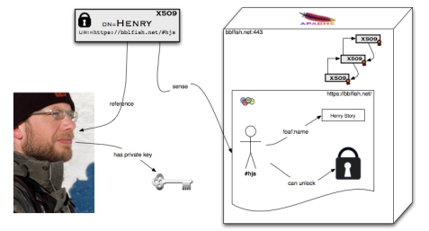
Identifiable Private Information
Information about behavior occurring in a context where public observation or recording is not expected, or information given for a specific purpose that is expected not to be made public
Private Information
Identity of participant is or may be readily ascertained by an investigator
Individually identifiable
Private information or specimens are individually identifiable when they can be linked to specific individuals directly or indirectly through coding systems.
Notes:
Private generally means that something isn’t expected to be used for anything other than the purpose it was provided for, like educational records for academic purposes or health records for insurance and medical purposes. If information is private and any member of the research team can identify the person to whom the information pertains, then the information is considered to be a human subject regardless of whether or not the study team collected the information themselves.

Slide 19
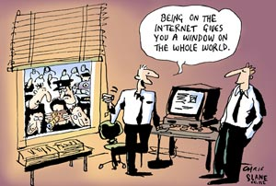
Publicly Available Information
Is it individually identifiable?
Notes:
Information that is publicly available like the yellow pages, public (not restricted) information on Facebook, or Twitter, is not considered to be a human subject.

Slide 20


Get IRB Determination
Thesis or Dissertation
IRB Official Determination
Notes:
If you’re not sure whether or not what you are doing meets the federal definition of human subjects research, contact us or submit a request in the portal for determination of human research.

Slide 21
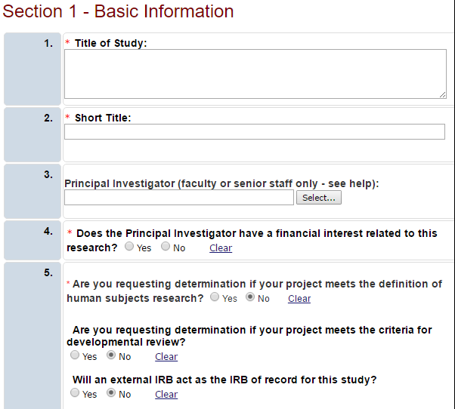
Notes:
In our submission form, be sure to answer “yes” to the first question in section 5 on the Basic Information page. Our form works like a wizard and will automatically change the following pages so that you only have to answer questions pertinent to us being able to determine whether you fall under our purview or not.

Slide 22
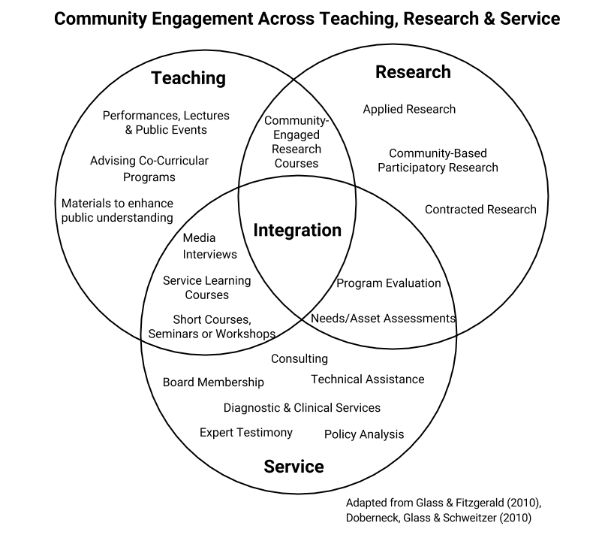
Expand Services of Agency
Research?
Human Subject?
Notes:
So let’s consider our first two sample studies and add a component where we will ask some motivation and behavior questions of the agency personnel to determine if the characteristics of the personnel also affect if or how well services are provided to the community. We may send the same surveys to agencies in other locations to obtain comparison data. While there are areas of our project that fall outside of the human research definition, the overall project and some components overlap with the research plan. Therefore, our whole project will be reviewed by the IRB.

Slide 23
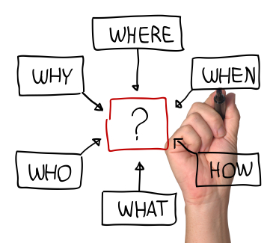
What does the IRB need to know?
Study location?
Time period?
Participant time commitment?
Study this topic?
Hypothesis?
PROTOCOL
Subjects?
Researchers?
Collect data?
Use data?
Data?
Specimens?
Notes:
So what do you need to tell the IRB? We need to know everything about your protocol in order for us to determine not only if it falls under our purview, but what risks to participants may be involved and who is engaged in the research.

Slide 24



Who are the researchers?
You are engaged if you…
Consent participants or answer questions about the research
Interact with
participants to get data
Analyze private, identifiable information
Look for policies on Engagement and Training at https://research.uga.edu/hso/policies-and-procedures/
Notes:
Anyone who conducts the consent process with participants or answers questions about the study, interacts with participants to obtain data, or analyzes information while it is still identifiable is considered engaged in the research. These individuals must complete CITI training and be listed on your study team.

Slide 25
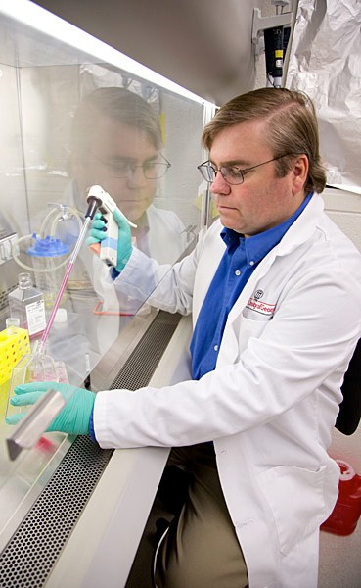
Collaborations
FAQ – “If I plan on collaborating with colleagues at other sites, will they need IRB approval at their own institutions?”
Are they engaged?
There are options:
  Rely on one IRB (NIH- Required)
  Each institution reviews the activities they are engaged in
May still require 2 submissions
38
Notes:
If the study falls under one of our 6 federally defined (or 2 institutionally defined FLEX) Exempt categories, a submission will be required at each engaged institution that has an IRB. If the study is reviewed as an Expedited or Full Board, each institution may conduct their own review, or there is also the option of relying on a single IRB for review. The review categories will be covered more thoroughly later on in the presentation. So plan early and communicate with your collaborators to see if they have an IRB and, if they do, find out what their preferred process is for reliance or additional review.

Slide 26
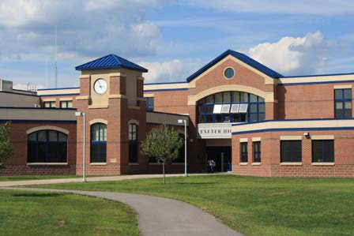
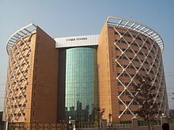
Working outside UGA
What if you have no collaborators and you just want to recruit people from another organization?
Obtain Site Authorization if the study is conducted at or targets a specific population at a location where you don’t have research privileges
39
Notes:
Some sites will require that their IRB take a look at your project even if they do not have any researchers engaged in the conduct of the project. Other sites do not have an IRB but require some sort of review or authorization process before they agree to let you recruit people at their locations or conduct research activities on their property. Start by contacting the site and determining the appropriate process to get permission to do your research at local institutions and organizations.

Slide 27

External Site Authorization
Person conducting Research
Specific detail of what research entails
Time period approved for research
Signed by someone with authority to grant research privileges
Notes:
Authorizations should be attached to your submission. Sometimes there are requested changes to your protocol prior to provision of authorization. If so, you will need to make the applicable changes requested by the site in order for your study to be approved. We can only approve a study to use external sites after we have the written authorization.

Slide 28
Sharing data or samples between sites/institutions
Obtain a Data Transfer or Materials Transfer Agreement from Innovation Gateway (gateway@uga.edu)
Retaining data/samples for future potential research
  Only with the appropriate consent for that use of data/samples
40
Notes:
Sometimes collaborations don’t involve going somewhere but they do involve sending or sharing data. If you will share your data with someone from another institution or organization, contact Innovation Gateway. They have the authority to enter into these agreements on behalf of UGA. These agreements are not necessary when sharing information with an individual participant but may be necessary when sharing with a community stakeholder organization.
If you are sharing data or retaining data for future research, be sure to indicate that in the study consent document. Identify how and with whom you will share information and whether or not the information is identifiable. If the research involved children and they may become adults while their study data is still identifiable, describe a method to obtain consent from the participants after they become adults.

Slide 29


Who are the participants?
Notes:
The final item to pay close attention to is your target population. Be sure to choose a population that is likely to provide information relevant to your research question and, if that population has any special attributes, describe how you will find and select them.

Slide 30



Vulnerable Populations
When some or all of the participants are likely to be vulnerable to coercion or undue influence, such as children, prisoners, pregnant women, mentally disabled persons, students, or economically or educationally disadvantaged persons, additional safeguards have been included in the study to protect the rights and welfare of these participants.
Notes:
There are three federally defined vulnerable populations: children, prisoners, and pregnant women. One common characteristic is the possibility of limited autonomy. Prisoners do not have the same level of autonomy as others. Parents need to provide permission for children to participate in research. Research involving pregnant women should not involve activities that could cause harm to the fetus. For these populations and any targeted population that may be subject to limited autonomy in certain situations (like students who are asked to be in a research study conducted by their teacher), be sure to describe how unbalanced relationships or limited comprehension will be reduced or otherwise addressed.

Slide 31


Submit to the IRB
IRB
Submission
31
Notes:
Now you’ve submitted to the black hole that is the IRB and you won’t hear from us for an eon, right? Nooooo….we’ll start making some determinations about your project.

Slide 32
First items for IRB review?
Research?
Human Subject?
Engaged? Category?
41
Notes:
As we covered before, we’re going to make sure that you are conducting research and that you have a human subject. We will determine who is engaged and then finally what category of review your study will require.

Slide 33
IRB Protocol Types
Exempt
  No more than minimal risk and fits within certain categories
  (6 federally defined and 2 institutional-specific):
  Certain types of educational research
  Certain projects involving collection of data by survey or interview
  Certain types of low-risk research limited to analysis of identifiable data
  Most research involving taste, food quality or consumer acceptance studies
Expedited
  No more than minimal risk and fits within certain categories described in the federal regulations
  (9 categories)
Full Committee
Notes:
Only 3 percent of studies are reviewed by one of our two IRB committees. The remainder are reviewed by Human Subjects Office staff alone or with the subject matter expertise of 1 or 2 board members. For 97 percent of the studies you should submit a minimum of 30 days prior to the date that you plan to begin recruitment. If you believe your study may require full board review (more than minimal risk) you will want to visit the schedule on our Human Subjects Office website. It is best to submit at least 30 days prior to the meeting that you would like for your study to go to.

Slide 34

Minimal Risk
def. – the probability and magnitude of harm or discomfort anticipated in the research are not greater than those encountered in daily life or during the performance of routine physical or psychological examinations.
34
Notes:
As you may have noticed, the level of review is not only dependent on the federally defined category of research that may apply to your study, it is also dependent on the level of risk associated with the study. Studies that are minimal risk, no more risk than encountered in daily life, may be determined to be Exempt or reviewed via Expedited procedure. Studies that are more than minimal risk will be reviewed by the committee.

Slide 35
Risk is a Function
Probability
Magnitude
Risk
Notes:
We assess risk as a function of probability and magnitude. The likelihood that something bad would happen and how bad it would be if it did happen are considered together when the IRB assesses risk.

Slide 36

How do you mitigate Risks?
Notes:
Therefore, if something bad could happen but you’ve taken proper precautions to reduce the likelihood that it may happen, your study may still be considered minimal risk.
Transcribing audio or video records, taking steps to code participant identities, and removing names and other identifiers promptly after data collection are all steps to reduce the likelihood of a breach of confidentiality. You could also collect data anonymously via paper and pencil survey packets if you’re collecting particularly harmful or sensitive data, like how often someone uses heroin or whether or not someone is HIV positive.

Slide 37
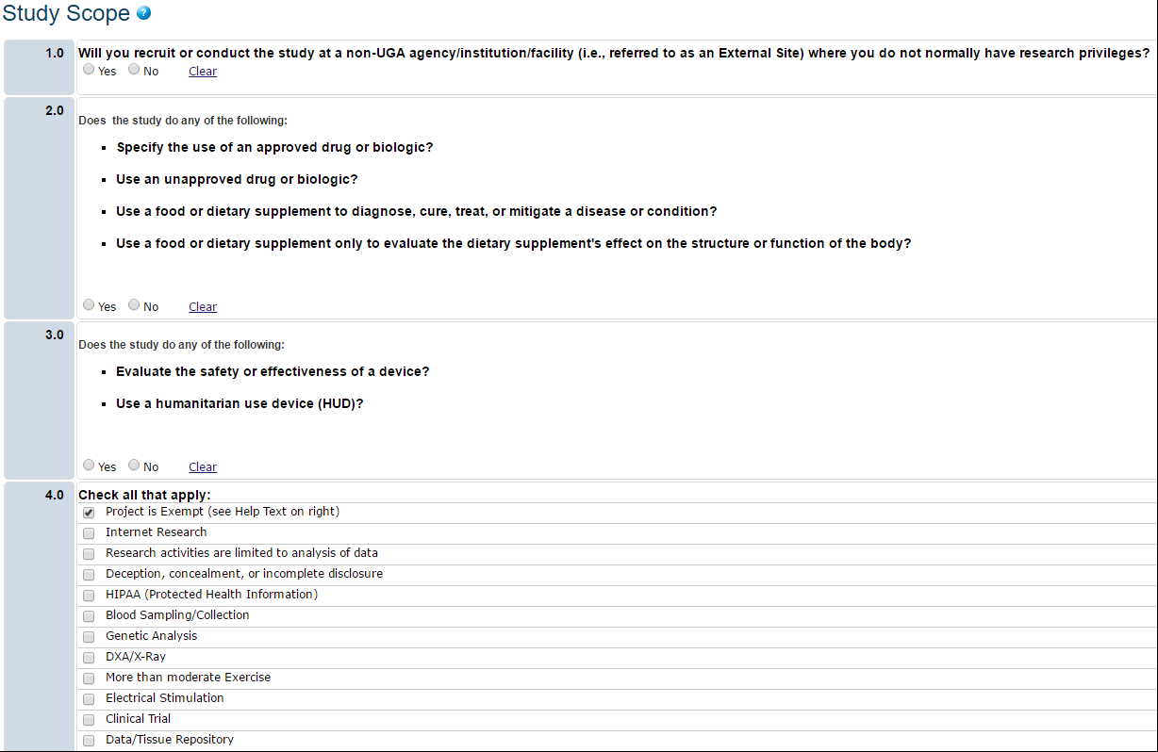
Notes:
If you think your project may fit into an Exempt category go ahead and check this box in the submission. If your assessment is incorrect we will let you know, but it in the mean time the form will be a little shorter and keep you from answering questions that you would not have to if your study was Exempt.

Slide 38
Challenges and Goals
Challenges:
Increase community involvement in research, including leadership roles in directing research and data collection
Raise awareness of the potential for community or collective risks in research
Address rising demand for and occurrence of disclosure of individual results to research participants
UGA IRB Goals:
Facilitate involvement of community members in the design, conduct, and analysis of data
Facilitate and advise researchers who inform community members about the results of the research study and utilize community members to help disseminate results
Notes:
There are some unique challenges when conducting community participatory research. The engagement of the community members in the planning stages and throughout the study conduct can make it necessary to modify the IRB-approved study frequently. It is important to keep data collection plans and processes flexible. Sometimes the disclosure of information may lead to a harmful representation of the community. Discuss this early with the community so that you can be responsive to their needs and help them deal with the possible results. More information can be found in the guidance posted on the Human Subjects Office website.

Slide 39
Who must agree to participate in the Research?
Consent – agreeing to participate personally
Parental Permission – agreeing for your child or legal ward to participate
Assent – a child’s agreement or adult with limited autonomy’s agreement to participate
Notes:
A very significant challenge when doing research in the community is making sure that you are cognizant of local laws pertaining to consent and that you design processes that ensure comprehension. If you may include individuals with cognitive impairment or limited autonomy, you may be required to seek permission from their legally authorized representative.

Slide 40

#1 Problem with Submissions
Notes:
The final challenge is a common challenge in any type of research. You will likely not sit down and complete your submission in one day. In most cases you will speak to stakeholders or community members or seek advice from scientific journals and realize that you need to make some changes along the way. Before you submit to the IRB, please give the entire submission a “once-over” to ensure that your attached documents (recruitment materials, consent document, and data collection materials) all reflect the same information and procedures that you describe in the submission itself.

Slide 41

IRB Portal Library
https://irb.ovpr.uga.edu
Click on Library Link
for:
Policies & Procedures
Templates
Checklist & Worksheets
User Guides
Notes:
We have many resources available on our website and in the IRB portal itself. Visit the library as you are filling out a submission online for templates and guidance documents.

Slide 42
After approval, what happens?
Comply with IRB’s review requirements for any continuing reviews and modifications.
Report any adverse events, unanticipated problems, and/or complaints to the IRB.
Close your study when you are finished
Comply with IRB’s record-keeping requirements.
Conduct research with integrity
Notes:
So once you have your IRB approval, is all the hard work done? Of course not. When the field work begins, there are still some activities that require additional submissions or contact with the IRB. If the project is not Exempt, submit any changes for review before implementing them. Pay attention to your expiration date and request for continuation if you are still enrolling participants, collecting new data, or analyzing identifiable information. If someone complains or is hurt, notify the IRB via a Report of New Information in the IRB portal. Close your study when it is complete and keep records for three years after that. If you have private health information from medical records, keep your records for six years. Finally, conduct your research with integrity. What do we mean by that?

Slide 43

conformity in adhering to official requirements
Notes:
Well up to this point, we’ve been discussing compliance. That means that your project follows all of the federal, state, and local laws pertaining to human research and the activities you are conducting and that you are following UGA’s policies and procedures.

Slide 44

Are these protections enough?
Notes:
But is compliance enough? It is the duty of the researcher to ensure that all persons and data are handled with the highest professional ethics. IRB review and approval is not a guarantee that the project will be conducted ethically.

Slide 45

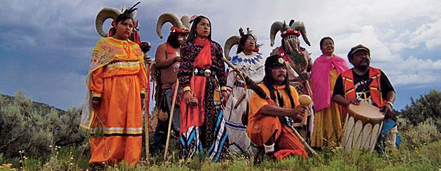
Havasupai Tribe
Notes:
Here’s a real world example. Members of the tiny, isolated Havasupai tribe in Arizona had given DNA samples to Arizona State University researchers starting in 1990, in the hope that they might provide genetic clues to the tribe’s devastating rate of diabetes. But they learned that their blood samples had been used to study many other things, including mental illness and theories of the tribe’s geographical origins that contradict their traditional stories. The consent form that participants signed simply stated that the blood would be used for genetic research but possible specific uses were not described. The tribe sued ASU and won a settlement along with possession of their remaining samples in 2010. The researcher was completely compliant with the IRB review of her project as were the other researchers who went on to use the de-identified samples for other studies. Remember, de-identified samples are not human subjects and, therefore, IRB approval for working with them was not required. But, from the perspective of the tribe members, significant harm was done to them even though the federal regulations didn’t apply to the subsequent studies. This example of group harm resulting even when the work is compliant with regulations has driven the movement in many universities to increase awareness of responsible conduct of research.

Slide 46
Hierarchy of Responsibility
Participant Welfare
Research Ethics
Research Results
Notes:
Responsible conduct of research isn’t limited to avoiding plagiarism and reporting of false results. It also involves making the right choice and considering potential harms over the scientific drive to gain new knowledge. Consider the participant first, then professional and discipline-specific ethics, then the possible knowledge to be gained. With this hierarchy considered first and foremost, studies will be designed ethically to produce sound results.

Slide 47
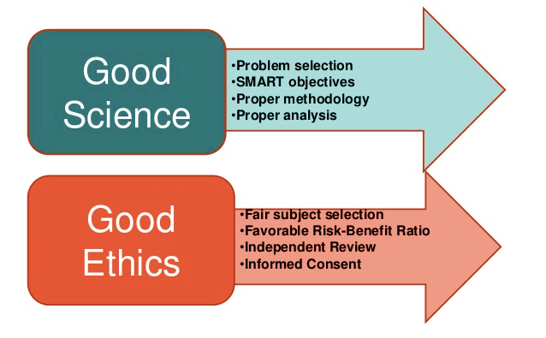
What makes Good Research?
Notes:
It’s not just about good science, it’s about good ethics. When valued equally, research quality is elevated.

Slide 48
Contact Information
Human Subjects Office
2nd Floor, Tucker Hall
706-542-3199
irb@uga.edu
facebook.com/UGAHSO/
twitter.com/ugahso
Kim Fowler - kfowler@uga.edu
Notes:
Please contact us with any questions you may have. We’re happy to help identify any compliance issues during the very important design phase so that your IRB review goes quickly and smoothly.

Slide 49
research.uga.edu

